Slide 1
Customer Segmentation for E-commerce
Team: 3
Sakshi Wadaskar & Yashraj Kadam
Notes:
Entered text
The goal of customer segmentation in e-commerce is multifaceted:
1. Enhanced Personalization: A personalize products suggestion, marketing messages and promotional offers to suit the interests and tastes of each group.
2. Improved Customer Experience: Ensure the smooth and exciting shopping adventure through coming up or building up the client's experience around their requirements, presenting and showing them the relevant content offerings and information at every touchpoint.
3. Increased Customer Retention: Cultivate customer bonding and retention by creating meaningful relationships by establishing personal connections and relevant communication patterns.
4. Optimized Marketing Strategies: Use marketing resources judiciously by centering the marketing strategy around your richest customer segments and by tailoring marketing campaigns to fall in line with the traits that represent each segmentation.
5. Maximized Revenue Generation: Grow revenue by deducing where the higher incomes are earned, high-value customers, and pricing strategies that align with segment preferences.
Thus, the main objective of segmentation of customers in the sphere of e-commerce is getting actionable insights from the data and turning them into customer understanding improvement, shopping experience personalization and business success of the company as a result.

Slide 2
Overview
The presentation outlines a strategic analysis of customer behavior using Instacart's vast order history. We dissect the methods and analytical techniques implemented to extract key insights for tailoring customer-centric shopping journeys. Our focus encompasses various analytical frameworks such as RFM analysis, associative rule mining, and segmentation through clustering, with predictive modeling to sharpen Instacart’s marketing and customer engagement tactics, aiming to elevate the consumer experience and business performance.

Slide 3
Introduction
In our "Customer Segmentation for E-commerce" introduction, we'll delve into the analytical expedition through Instacart’s extensive order data, with an eye toward deciphering complex consumer behavior. This foundational work lays the groundwork for advancing tailored e-commerce strategies, leveraging key segmentation techniques for a granular understanding of customers, and guiding Instacart’s tactical decisions to refine the user experience. We'll unveil how strategic data analysis can steer marketing and operational enhancements in the competitive landscape of online grocery delivery.

Slide 4
Project Background
Our project explores Instacart's treasure trove of data to dissect customer shopping patterns. With over 3 million orders, the project's backdrop focuses on discerning habits that could empower more nuanced marketing strategies and inventory decisions. This analysis is geared towards grasping the dynamics of grocery shopping and utilizing this understanding to predict future order contents, ultimately driving a personalized user experience and streamlining business operations.

Slide 5
Project Motivation
The motivation for segmenting customers in the e-commerce domain is rooted in the goal to cater specifically to each segment's unique needs and preferences. This strategic segmentation allows companies to tailor their marketing efforts more accurately, customizing product recommendations and crafting specialized promotions that resonate with distinct customer groups. This precision in marketing leads to more effective use of resources, enabling businesses to focus on the most profitable customer segments and enhance overall sales and profit margins.

Slide 6
Project Goals
The goal of customer segmentation in e-commerce is multifaceted:
1. Enhanced Personalization: A personalized products suggestion, marketing messages and promotional offers to suit the interests and tastes of each group.
2. Improved Customer Experience: Ensure the smooth and exciting shopping adventure through coming up or building up the client's experience around their requirements, presenting and showing them the relevant content offerings and information at every touchpoint.
3. Increased Customer Retention: Cultivate customer bonding and retention by creating meaningful relationships by establishing personal connections and relevant communication patterns.
4. Optimized Marketing Strategies: Use marketing resources judiciously by centering the marketing strategy around your richest customer segments and by tailoring marketing campaigns to fall in line with the traits that represent each segmentation.
5. Maximized Revenue Generation: Grow revenue by deducing where the higher incomes are earned, high-value customers, and pricing strategies that align with segment preferences.
Thus, the main objective of segmentation of customers in the sphere of e-commerce is getting actionable insights from the data and turning them into customer understanding improvement, shopping experience personalization and business success of the company as a result.

Slide 7
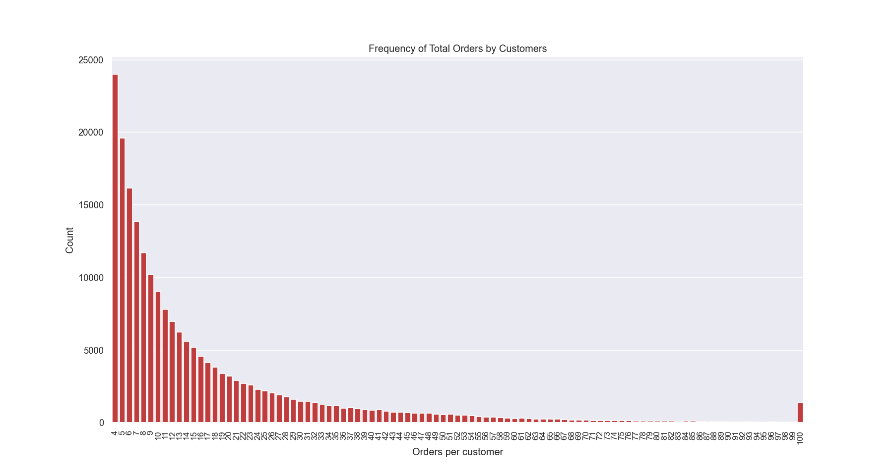
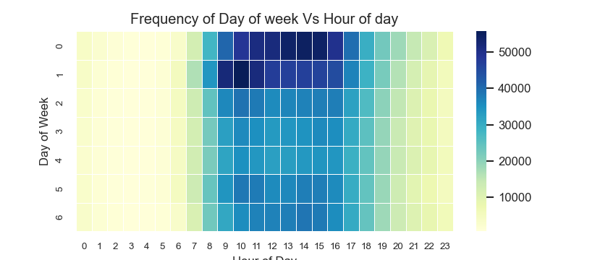
Dataset Description
The dataset features:
- Aisles: Containing information on 134 unique aisles.
- Departments: Detailing 21 unique departments.
- Orders: Showcasing orders from 206,209 users totaling 3,421,083, divided into Prior, Train, and Test sets with distinct distributions for Prior. Each user's orders range from 0 to 100. Weekend trends suggest most grocery shopping occurs then, particularly Saturday afternoons and Sunday mornings. Data indicates a weekly ordering cycle, with peak times inferred from the analysis of days since the last order and a detailed heatmap of order times.

Slide 8
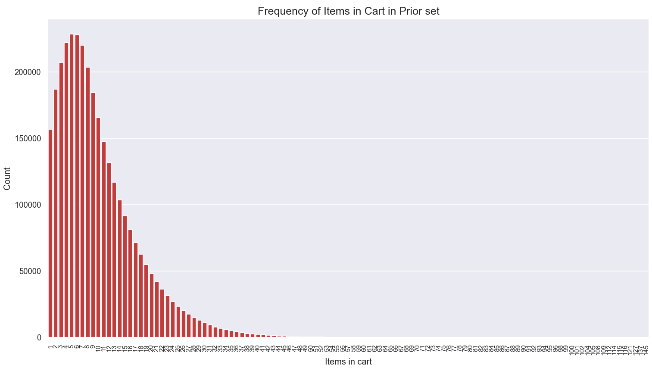
Dataset Description(Cont’d)
Products: This file contains information on a total of 49,688 products, along with their respective aisles and departments.
Order_products_prior:
- This file provides details on the products that were ordered, their order sequence, and whether they were reordered.
- It covers a total of 3,214,874 orders, involving 49,677 distinct products.
- Analysis suggests that most orders consist of 1-15 items, with a maximum of 145 items per order, as indicated by the "Count VS Items in cart" plot.
- Approximately 58.97% of items in this dataset were reordered.

Slide 9
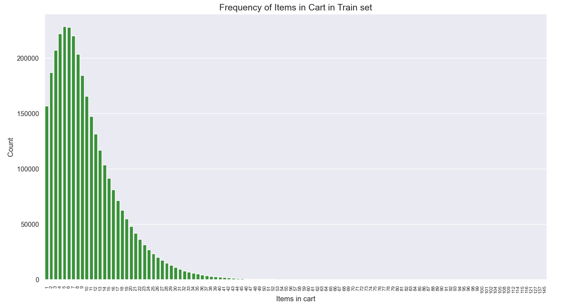
Dataset Description(Cont’d)
Order_products_train:
This file provides information on the products that were ordered, their order sequence, and whether they were reordered.
It includes data from a total of 131,209 orders, encompassing 39,123 unique products.
Analysis from the 'Count VS Items in cart' plot suggests that the majority of orders contain 1-15 items, with a maximum of 145 items per order.
The percentage of reordered items in this dataset is 59.86%.

Slide 10
Methodology Overview
1. Data Preprocessing and Cleaning:
We will Perform data preprocessing which entails filling in missing values, removing duplicates, and converting categorical variables to numeric, and apply data normalization or standardization for consistent expression of the features by their magnitude. With data exploration and an in-depth understanding of its structure, find out if the data contains any troublesome situations or biases.
2. Exploratory Data Analysis (EDA):
We will apply an EDA to find out about customer behavior, liking and character. With histograms, scatterplots and heatmaps allowing to see the scheme of things and relationships between the variables, it will be easy to spot patterns and correlations. We will establish customer demographics, purchase history as well as engagement metrics, and look for solution possibilities this segmentation presents. It is also important to analyze connections between different customer segments and effect indicators, like a customer lifetime value or purchase frequency.
3. Feature Engineering:
Feature extraction in the script involves aggregation, grouping, and cumulative counting to derive summary statistics and temporal patterns. Binary encoding is used to represent categorical features efficiently. New features are derived from existing ones, capturing important characteristics of the data. Missing values are handled appropriately to ensure data completeness. The technique involves a combination of domain knowledge and statistical methods to create informative features for modeling and analysis.

Slide 11
Methodology Overview(Cont’d)
4. Model Selection: Customer Segmentation:
Utilized clustering techniques (e.g., KMeans) based on product aisles to segment customers.
Reduce dimensionality using techniques like Principal Component Analysis (PCA) for visualization and clustering.
Market Basket Analysis:
Applied Association Rule Mining techniques (e.g., Apriori Algorithm) to discover associations between products frequently purchased together.
Calculated support, confidence, and lift for product pairs to identify significant associations.
Utilized the insights for cross-selling, up-selling, and marketing strategies.
Machine Learning Model Development:
Prepare the dataset for modeling, including feature engineering, data preparation, and splitting into train and test sets.
Build machine learning models (e.g., XGBoost, Neural Network) to predict which previously purchased products will be in a user’s next order.
Utilize features extracted from previous orders, user behavior, product popularity, and aisle/department characteristics.
Handle class imbalance using techniques like cost-sensitive learning.
Evaluate model performance using metrics such as AUC score, Confusion Matrix, and ROC curve.
Interpret feature importance to understand the factors influencing product reorder predictions.

Slide 12
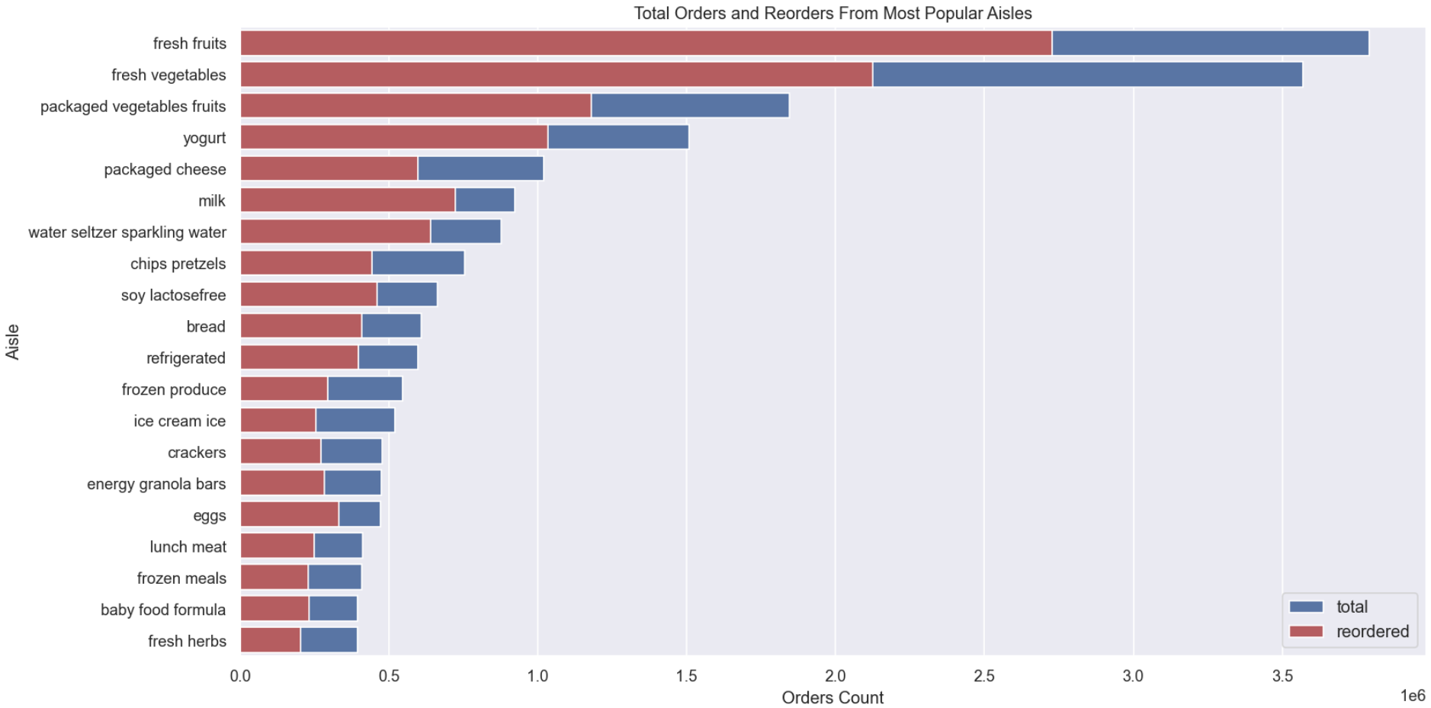
Exploratory Data Analysis(EDA)
For the analysis, all separate data files were merged into a single dataframe, and to accommodate it within memory constraints, its size was reduced by 50% (from 4.1 GB to 2.0 GB) through type conversion. This was done without sacrificing any information.
This plot shows most popular aisles based on total products bought.

Slide 13
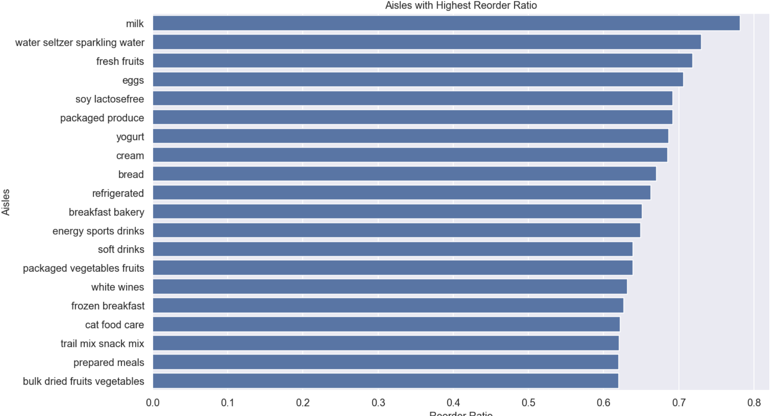
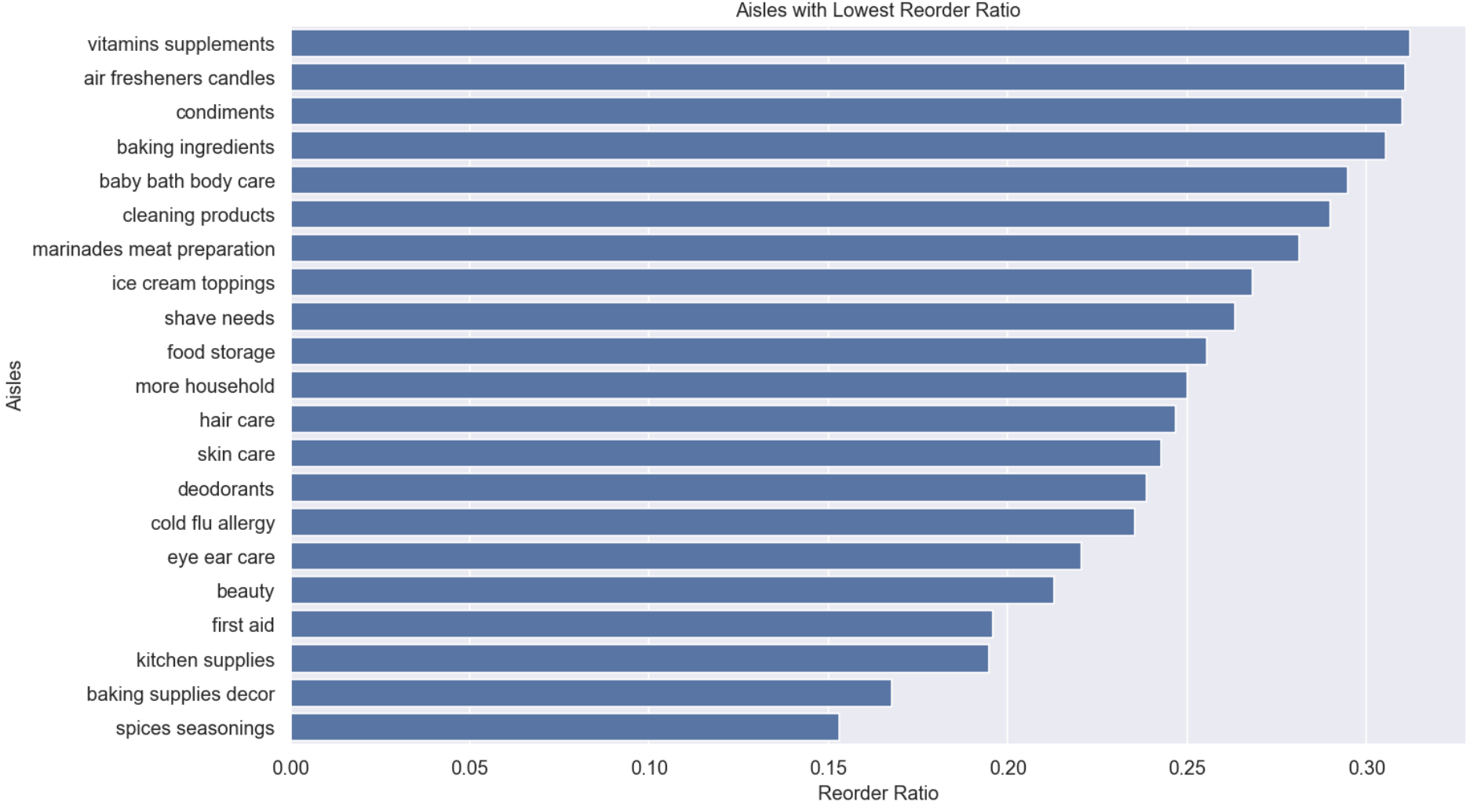
Exploratory Data Analysis(EDA)
As we can see in below plot that the reorder percentage of day-to-day food items is high and for other products such as vitamins, first-aids, beauty products, etc. reorder percentage is low. This is true as we buy only groceries regularly and do not buy those items in every order.

Slide 14
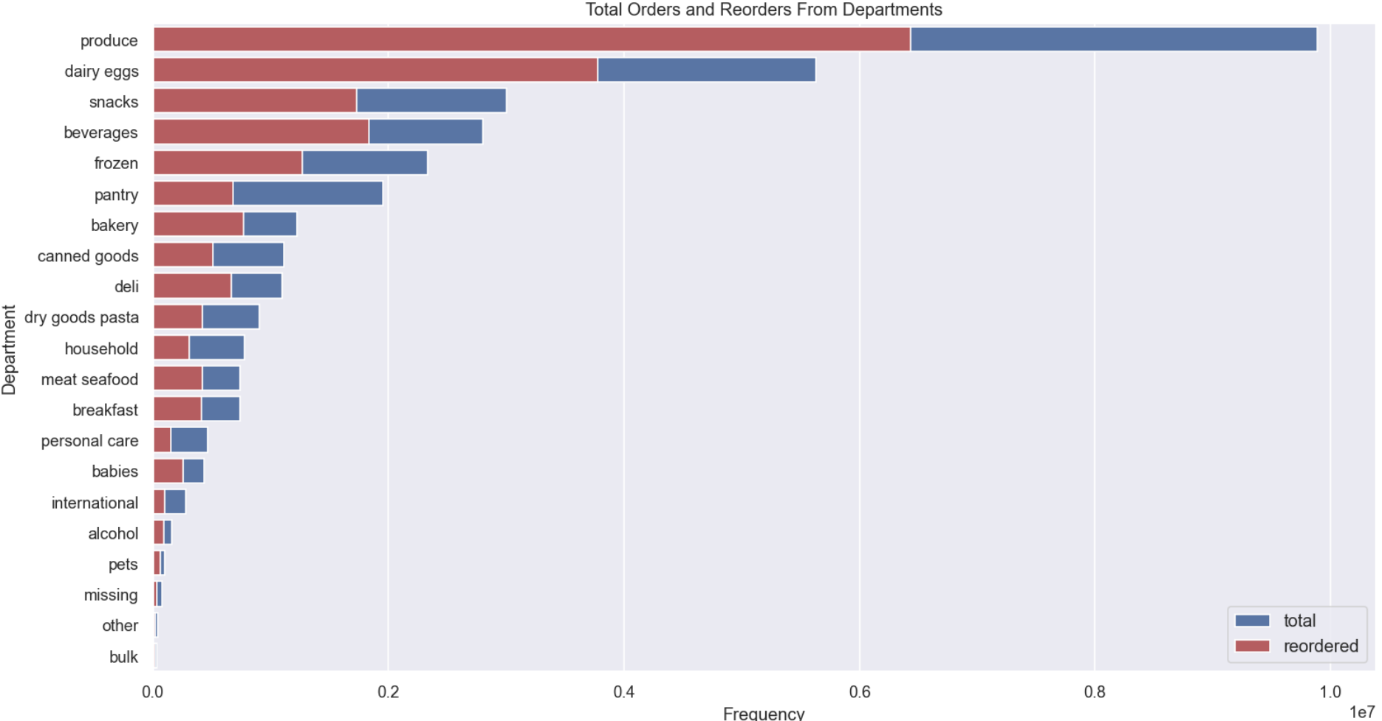
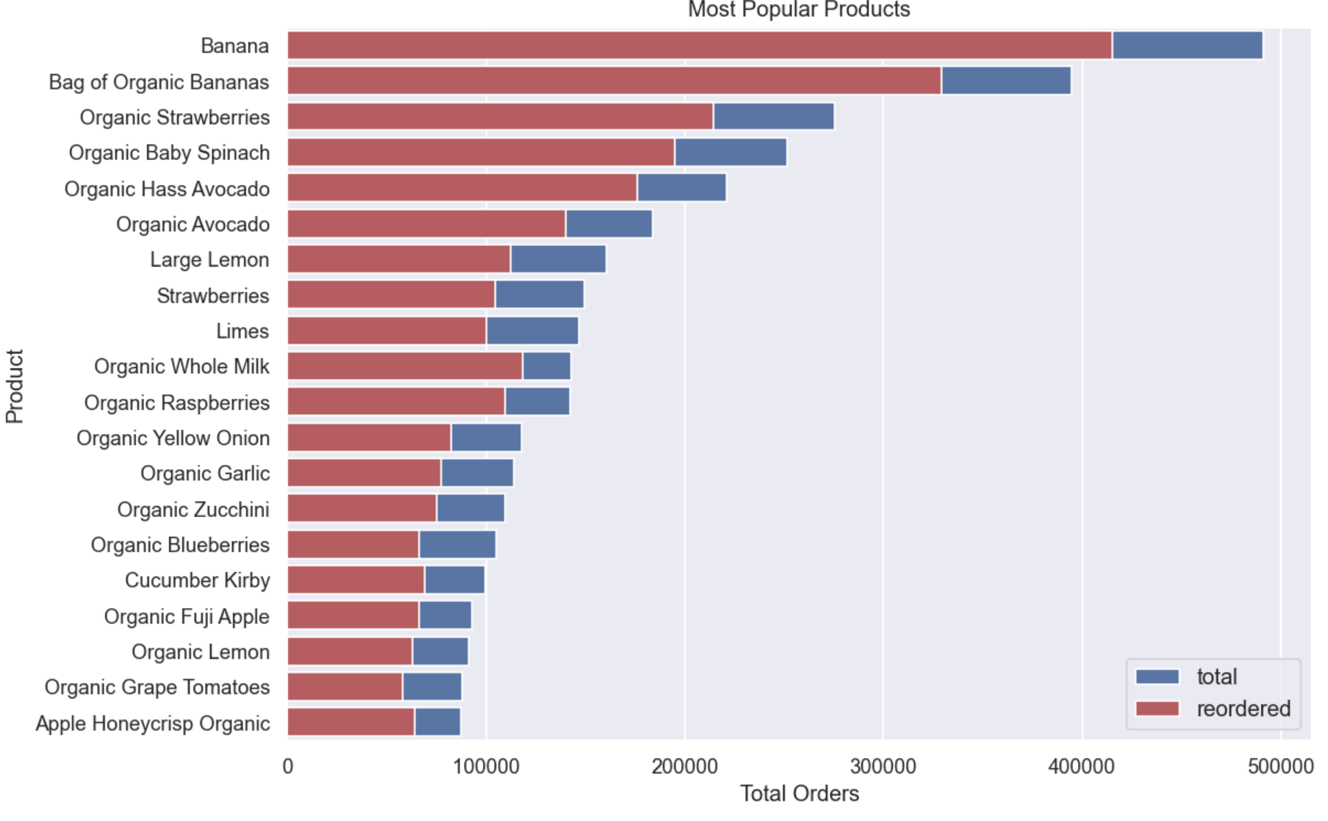
Exploratory Data Analysis(EDA)
The above plot shows popular departments. The store layout should be in a way that popular departments are very near to each other.
The above plot shows most popular products. As we can see there are many organic products in the most popular products.

Slide 15
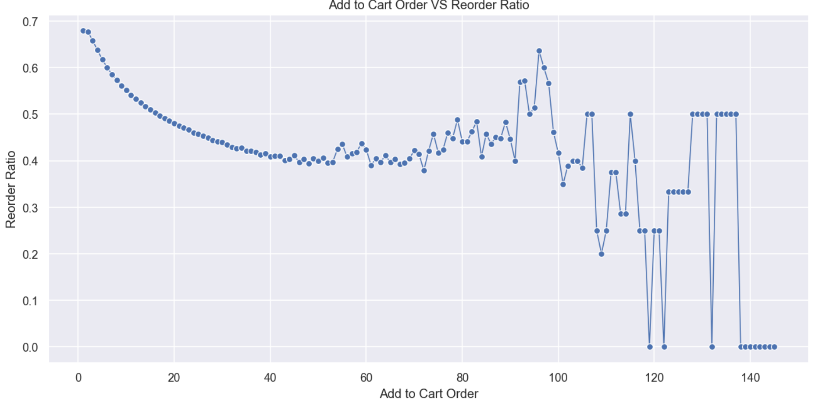
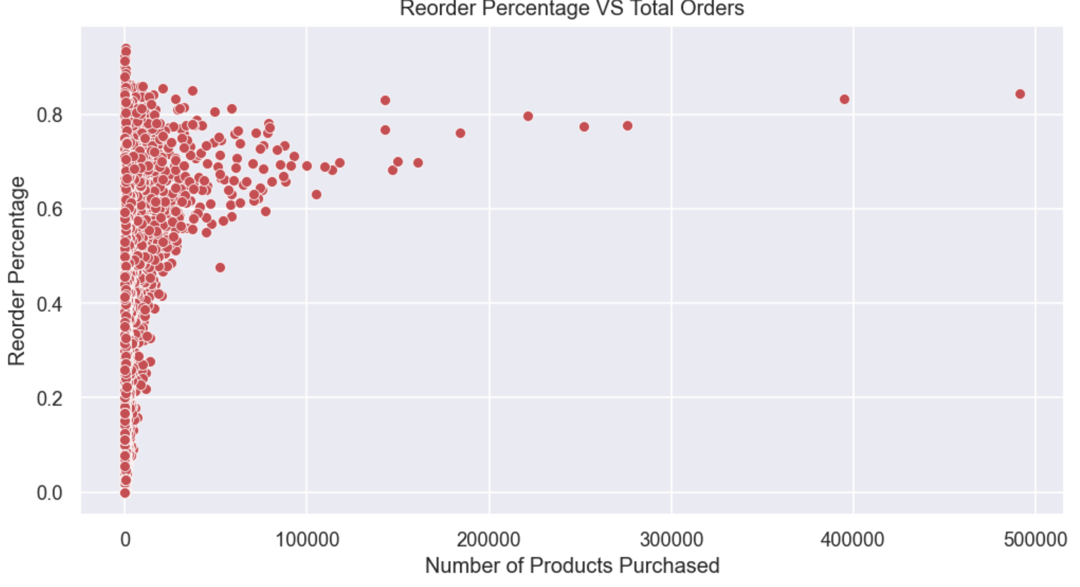
Exploratory Data Analysis(EDA)
We can plot add-to-cart-order and mean reorder percentage. As we can see the lower the add-to-cart-order higher is the reorder percentage. This makes sense as we mostly buy things first that are required on day-to-day basis.
In the above plot of reorder percentage and number of product purchase, we see a ceiling effect. Many people try different product once and they do not reorder again. Also, there are users who buy certain products regularly.

Slide 16
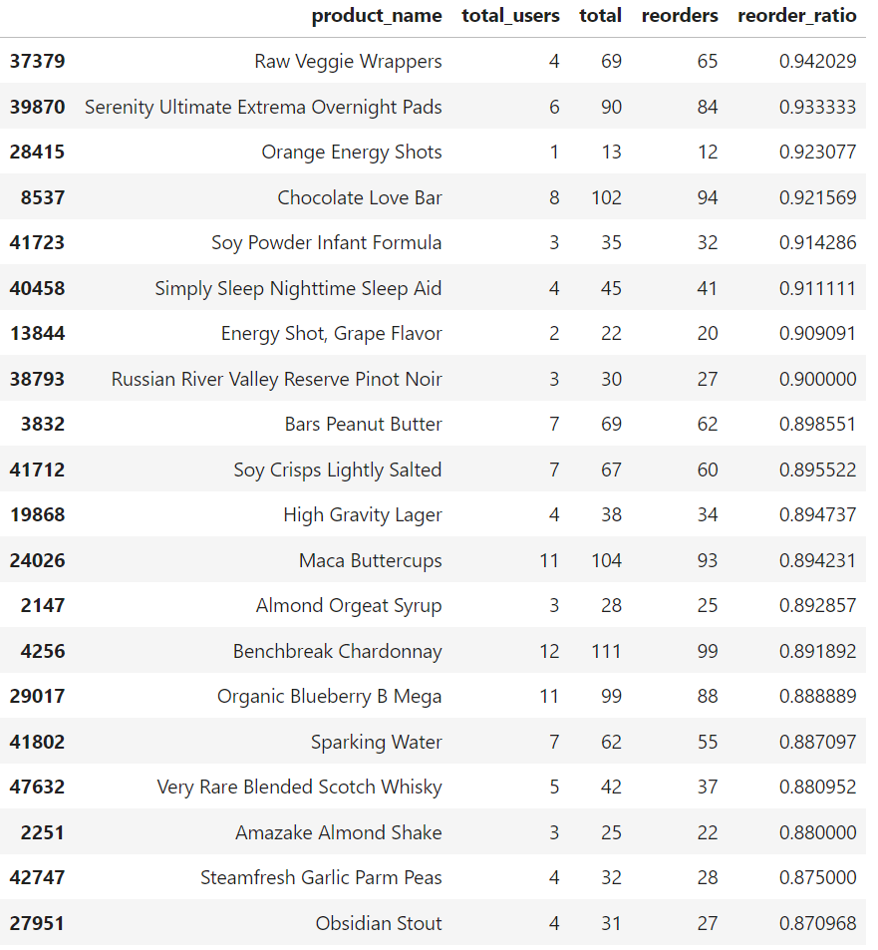
Exploratory Data Analysis(EDA)
We can see that the total unique users of products having highest reorder ratio are only few (1-15 only). This means that these users like these products and would buy regularly.

Slide 17
Feature Engineering
Feature Extraction Techniques
In our project, feature extraction plays a crucial role in distilling meaningful insights from the raw data. The following techniques were employed to transform the data and generate informative features:
1. Aggregation
Definition: Aggregating data based on specific attributes (e.g., product ID, user ID) to derive summary statistics.
Examples: Calculating mean, sum, count, standard deviation, etc., to condense information into meaningful features.
Purpose: Summarizing patterns and characteristics of the data for analysis and modeling.
2. Grouping and Cumulative Counting
Definition: Grouping data by certain attributes (e.g., user ID, product ID) and performing cumulative counting.
Examples: Determining how many times a user has bought a particular product or how many orders a user has placed.
Purpose: Understanding user behavior and purchase patterns over time.
3. Binary Encoding
Definition: Converting categorical features (e.g., aisle, department) into binary representations.
Examples: Using techniques like one-hot encoding or binary encoding to represent categorical data.
Purpose: Facilitating modeling by transforming categorical variables into numerical representations.

Slide 18
Feature Engineering(Cont’d)
4. Derived Features
Definition: Creating new features by combining or transforming existing ones.
Examples: Calculating the percentage of users that buy a product a second time or deriving features from historical purchase behavior. Purpose: Capturing complex relationships and patterns in the data.
5. Temporal Analysis
Definition: Analyzing temporal patterns such as day-of-week, hour-of-day, or days-since-prior-order.
Examples: Extracting features related to ordering behavior over time.
Purpose: Identifying trends and seasonality in user behavior.
6. Missing Value Handling
Definition: Handling missing values appropriately to ensure completeness of the data.
Examples: Imputing missing values or treating them as a separate category.
Purpose: Maintaining data integrity and reliability for analysis and modeling.

Slide 19
Results and Analysis
Customer Segmentation
Since there are a lot of different products in our dataset, we'll simplify things by grouping them into categories called "aisles." But even with aisles, we still have too many features to work with. So, we'll use something called Principal Component Analysis (PCA) to help us find new ways of looking at our data that make it easier to group similar items together. It's like squishing all the information into a smaller space, while still keeping the important stuff. This will make it easier for us to organize the products into groups based on their similarities.

Slide 20
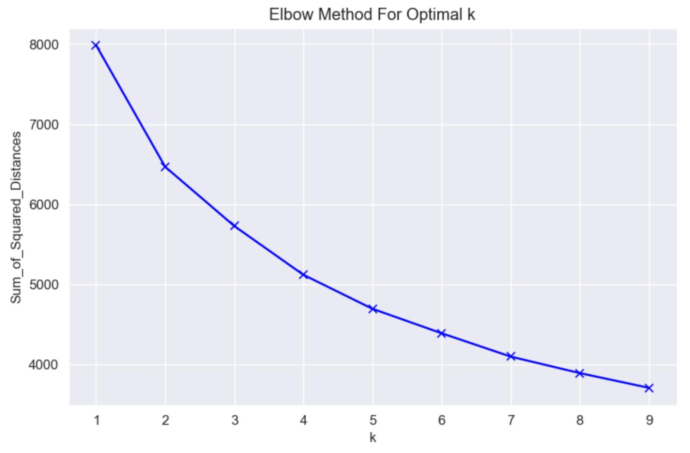
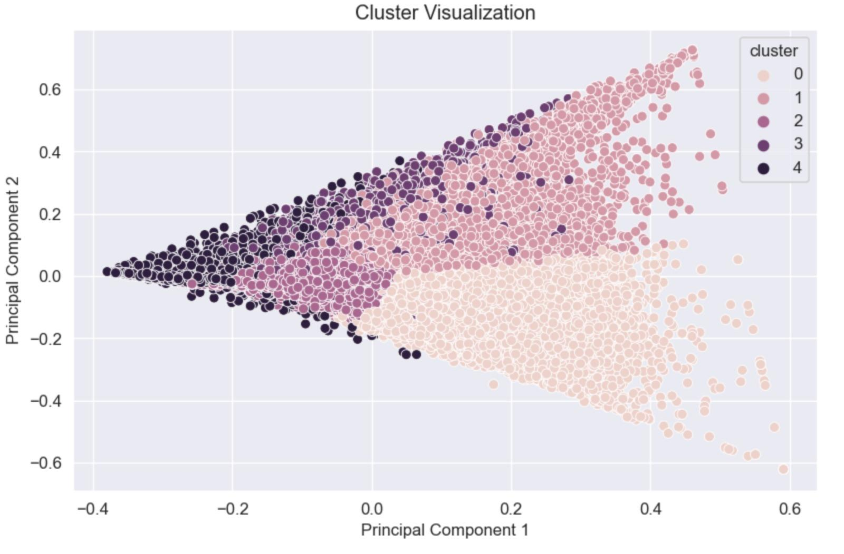
Results and Analysis
Customer Segmentation
K means clustering using 10 Principal components.
Optimal number of cluster has been chosen as 5 using Elbow Method as shown above.
The clustering can be visualized along first two principal components as above.

Slide 21
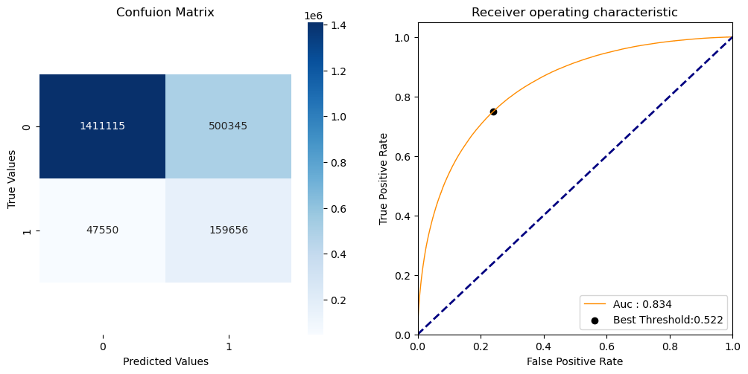
Results and Analysis
XGBoost
The confusion matrix for our XGBoost model presents a comprehensive picture of its performance. With a substantial number of true negatives and true positives, the model demonstrates a strong ability to discern between the classes. Notably, the receiver operating characteristic curve, or ROC curve, complements this matrix with an AUC (Area Under the Curve) of 0.834, indicating a high level of model accuracy.
A standout point is the 'Best Threshold' marked at 0.522, which is the optimal cutoff point balancing sensitivity and specificity for our predictions. This data-driven threshold signifies where our model shifts from classifying a non-reorder to a reorder, which is a pivotal insight for making informed decisions on inventory management and customer targeting strategies.

Slide 22
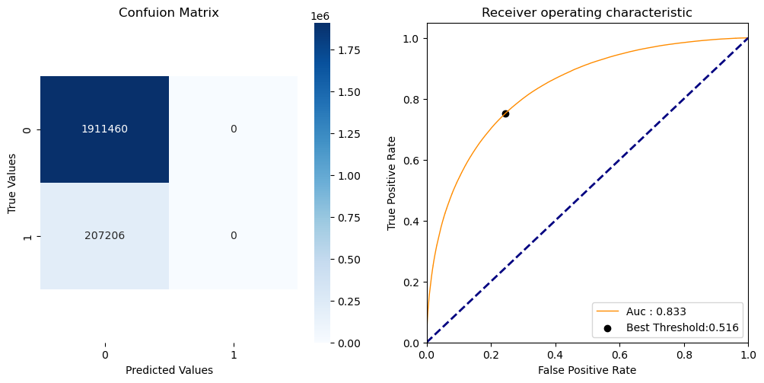
Results and Analysis
ANN
The ANN's performance showcases exceptional precision, as shown by the concentration of true negatives in the confusion matrix, and the complete absence of false positives and false negatives indicates a robust predictive capability within the dataset's scope.
The ROC curve's AUC at 0.833 affirms the model's strong ability to differentiate between the classes, with the optimal balance point for classification precision marked at a threshold of 0.516. This suggests a finely tuned model that can be pivotal in enhancing user engagement and operational efficiency.

Slide 23
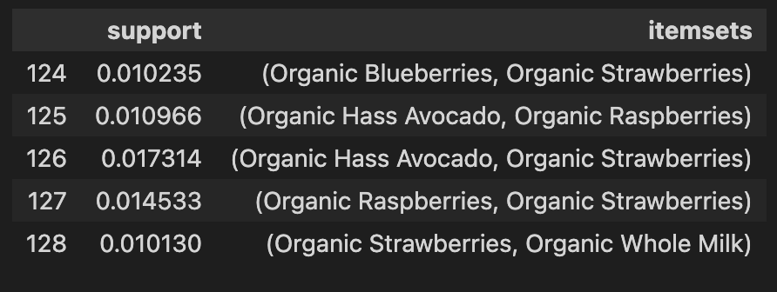
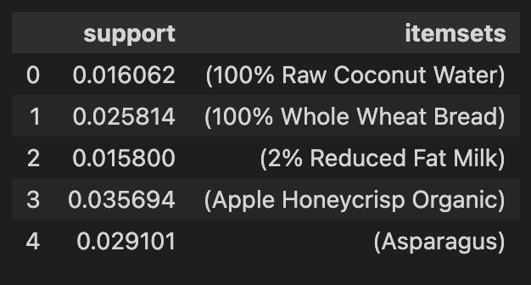
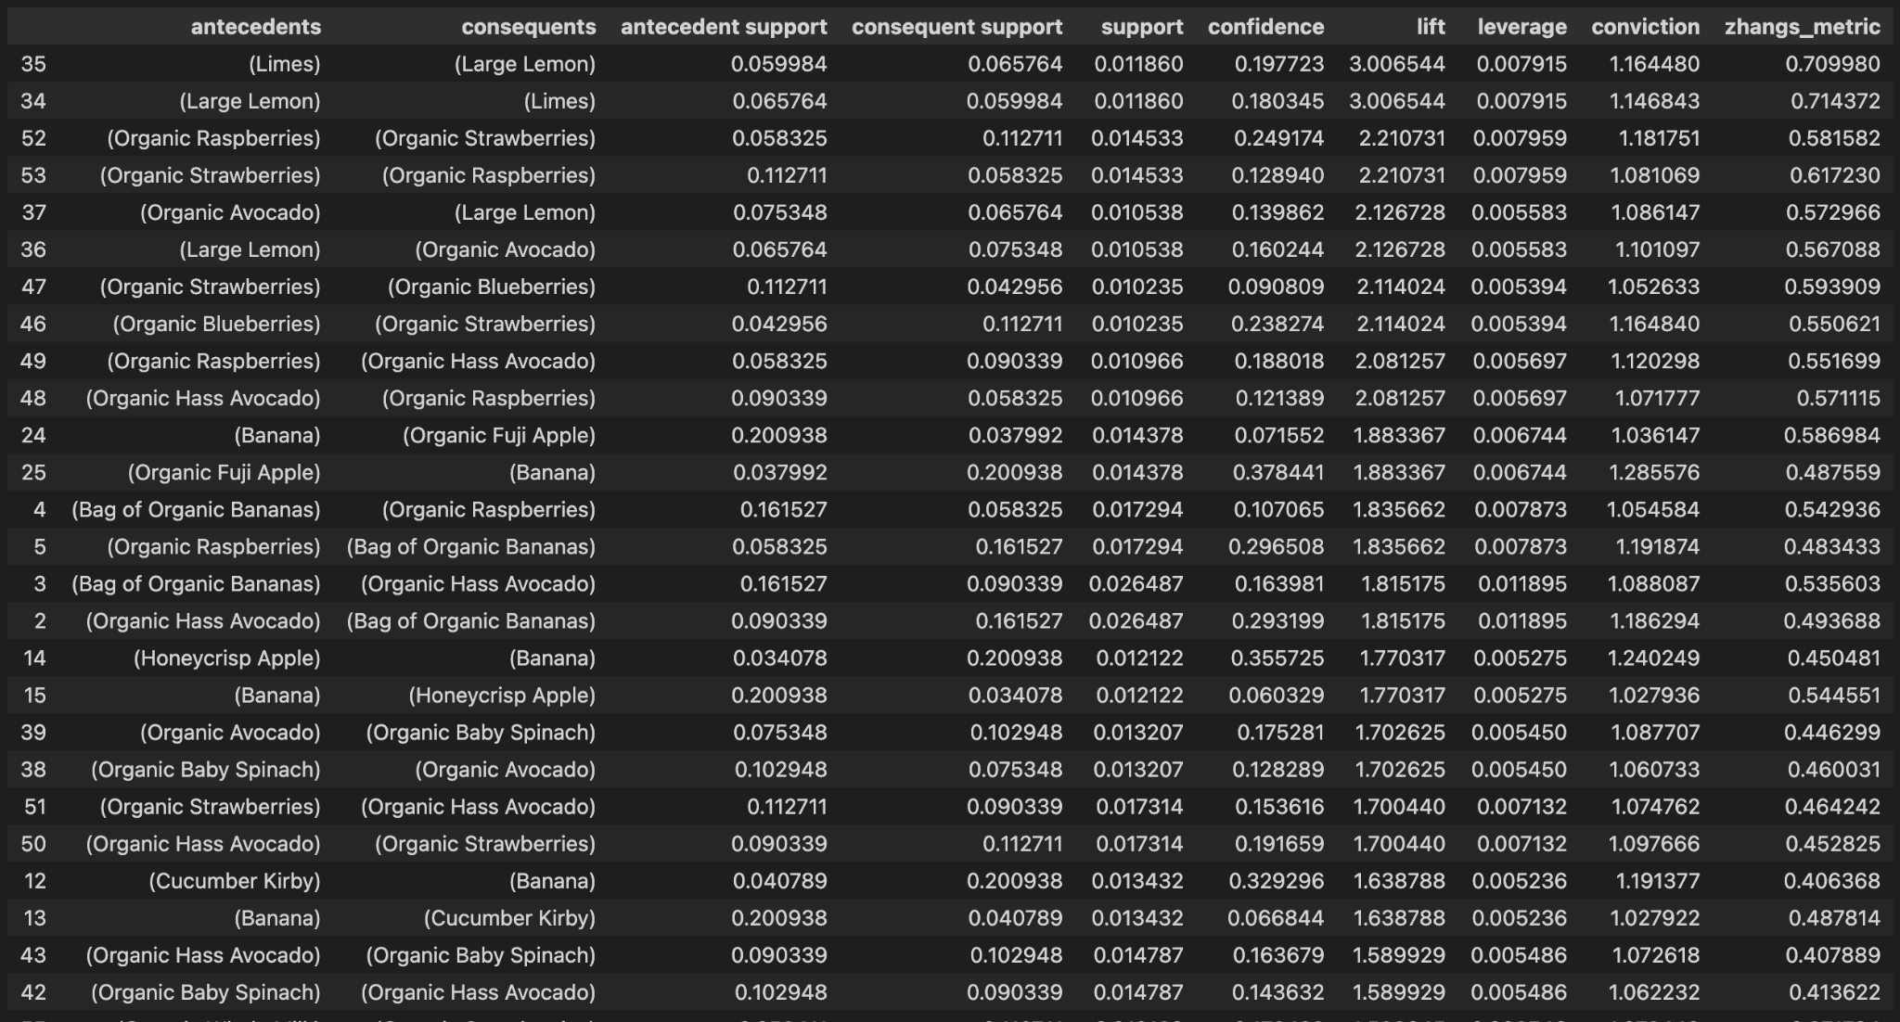
Results and Analysis
Customer cart Analysis
Our project leverages associative rule mining(e.g., Apriori Algorithm) to discover associations between products frequently purchased together, revealing that organic products, such as raspberries and avocados, frequently co-occur in shopping baskets. This suggests a trend towards healthy choices among our customers. By identifying such patterns, we can tailor our inventory and recommendations to better meet our customers' preferences. Here we have Calculated support, confidence, and lift for product pairs to identify significant associations. Utilized the insights for cross-selling, up-selling, and marketing strategies.

Slide 24
Conclusion
In conclusion, The Customer Segmentation project employed a multifaceted methodology, including data collection, exploratory data analysis, feature extraction, customer segmentation, market basket analysis, and machine learning model development.
This comprehensive approach provided valuable insights into customer purchasing behavior, product associations, and predictive modeling for product reorder predictions. While both the ANN and XGBoost models demonstrated potential in predicting reordered products, further refinement and optimization are needed to address their individual strengths and weaknesses effectively. This project highlights the significance of leveraging data-driven strategies to enhance business tactics and enhance the overall customer shopping experience.

